Slide 1
AEL Funding Sources and Authorities
Lori Slayton, Adult Education and Literacy
AEL WIOA Summer Institute: June 20 - 23, 2017

Slide 2
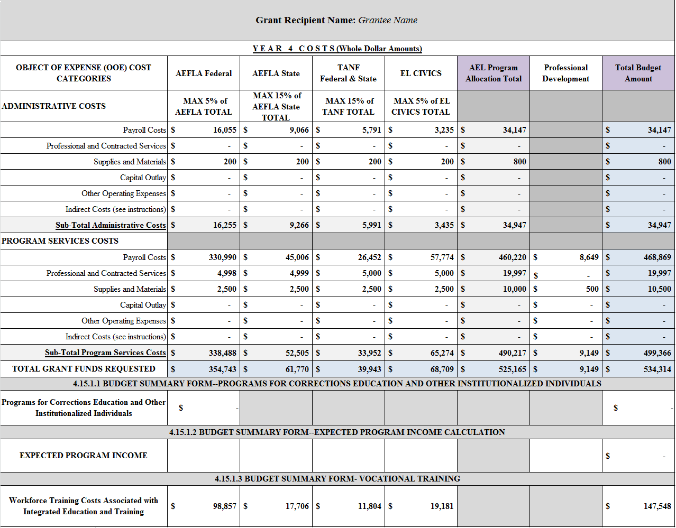
AEL Program Funding (across the top of your B-1)
Notes:
The program funding can be found across the top line of your B-1; this one is for the Core 34, however, many of the Special Initiative contracts may have only one or two funding sources, as well as admin or no admin, depending on the project.

Slide 3
Sources of AEL Funding: B-1 and CDER
B-1:Federal AEFLA funds
CDER: AEL
B-1: AEFLA State
CDER: GR (General Revenue)
B-1: TANF Federal and State
CDER: TAN
B-1: EL Civics
CDER: IET ELC
B-1: Professional Development
CDER: Professional Development
Notes:
It’s a great, unknowable mystery about why these terms are not consistent, not even google knows! While PD on the B-1 and in CDER are the same, PD is State Leadership funding and several of our contracts are funded with State Leadership funds that is not necessarily for Professional Development. So, while PD is always SL, SL is not always PD.

Slide 4
Sources of AEL Funding
B-1:Federal AEFLA funds
CDER: AEL
There is only one thing you can do with your Federal AEFLA dollars that you cannot do with other AEL funding sources…..anyone??
It’s a tracked sub-set of your Federal AEFLA dollars, located at the bottom of your B-1…?
That’s right, CORRECTIONS!

Slide 5
AEFLA Federal: Corrections
Chris LeFeve, TWC/AEL Program Specialist
Chris.lefeve@twc.state.tx.us
Veronica Moore, TWC/AEL Program Specialist
Veronica.moore@twc.state.tx.us
Notes:
Lori: introduce Chris and Veronica

Slide 6
8 Allowable Activities Under Corrections
463.60(b) The funds described in subsection (a) must be used for the cost of educational programs for criminal offenders in correctional institutions and other institutionalized individuals, including academic programs for—
(1) Adult education and literacy activities
(2) Special education, determined by eligible agency
(3) Secondary school credit
(4) Integrated education and training
(5) Career pathways
(6) Concurrent enrollment
(7) Peer tutoring

Slide 7
Continued: 8 Allowable Activities Under Corrections
8) Transition to re-entry initiatives and other post-release services with the goal of reducing recidivism.
1) may include educational counseling or case work to support incarcerated individuals’ transition to re-entry initiatives and other post-release services
2) assisting incarcerated individuals to develop plans for post-release education program participation
3) assisting students in identifying and applying for participation in post-release programs
4) and performing direct outreach to community-based program providers on behalf of re-entering students
Priority usage of these funds must be given to individuals who are likely to return back to the community within 5 years of receiving services.

Slide 8
Transition to Reentry and Post-Release Services : EXPLANATION
Transition to Re-entry and Post-Release Services means services such as educational counseling or case work to support incarcerated individuals' transition to re-entry and other post-release services.
Examples include : Assisting incarcerated individuals to develop plans for post-release education program participation, assisting students in identifying and applying for participation in post-release programs, and performing direct outreach to community-based program providers on behalf of re-entering students. Such funds may not be used for costs for participation in post-release programs or services.
Transition to Reentry and Post-Release Services IS an Intensive Services Model for Career Pathways (Tier II)

Slide 9
Federal and State AEL Funds
§805.3. Federal and State AEL Funds.
Federal AEL funds may be used for AEL programs for out-of-school individuals who have attained 16 years of age and who are not enrolled or required to be enrolled in secondary school under state law and: (1) lack sufficient mastery of basic educational skills to enable the individuals to function effectively in society; (2) do not have a secondary school diploma or its recognized equivalent, and have not achieved an equivalent level of education; or (3) are unable to speak, read, or write the English language.
(b) State AEL funds are to be used for AEL programs for out-of-school individuals who are beyond the compulsory age of attendance unless specifically exempted from compulsory school attendance by Texas Education Code §25.086 and: (1) lack sufficient mastery of basic educational skills to enable the individuals to function effectively in society; (2) do not have a secondary school diploma or its recognized equivalent, and have not achieved an equivalent level of education; or (3) are unable to speak, read, or write the English language.
Notes:
These are the AEL rules that define the whom you may serve with Federal and State AEFLA funds.

Slide 10
AEFLA Federal and IET/EL Civics
Section 4 of Core 34 Contracts – Eligibility
4.1 The Eligible Population to be served under this grant consists of individuals in the following categories:
AEFLA Federal Funds and Integrated English Literacy and Civics Education funds (IEL/CE): Out-of-school individuals who have attained 16 years of age and who are not enrolled or required to be enrolled in secondary school under state law and who:
are basic skills deficient;
do not have a secondary school diploma or its recognized equivalent, and have not achieved an equivalent level of education; or
are an English language learner
AEL Letter 04-16, Change 1: http://www.twc.state.tx.us/files/partners/ael-04-16-change-1-twc.pdf
Notes:
Section 4 of your Year 4 contracts address AEFLA Federal funds and IET/EL Civics as having the same eligibility requirements for use of funds. However, the funds are allocated and tracked separately. AEL Letter 04-16, Change 1

Slide 11
AEL Letter 04-16, Change 1: IET/EL Civics
PURPOSE: AEL Letter 04-16 provided Adult Education and Literacy (AEL) grantees with updated information and guidance on implementing Workforce Innovation and Opportunity Act (WIOA) §243, Integrated Education and Training English Literacy and Civics Education (Integrated EL Civics). This updated AEL Letter:
• removes some language related to enrollment targets for Integrated EL Civics programs; and
• removes language related to the assessment of English language learners.
Notes:
Anson to speak on the update

Slide 12
Sources of Funding: TANF
Section 4.2 of AEL Contract: Eligibility for Services Funded by Temporary Assistance to Needy Families (TANF) Adult education is considered a work activity to assist TANF recipients in becoming self-sufficient. …..
4.2.6 Documentation must be collected that a participant qualifies for use of TANF funding for AEL services
Refer to AEL Letter 01-15, Change 1 for guidance on TANF eligibility
http://www.twc.state.tx.us/files/partners/ael-01-15-change-1-twc.pdf
Notes:
TANF still trending as the most difficult documentation for eligibility to obtain worldwide! If you are not familiar with this letter, you should be. It specifically addresses eligibility and documentation requirements to use your TANF funds. Oh, I forgot to mention…

Slide 13
All Funding Sources
Section 4.4 -
The Grantee shall determine eligibility for each participant prior to participant receiving any services funded through this grant. The Grantee shall document and maintain confidential eligibility documentation files for each participant receiving services funded through this grant. Maintenance of these eligibility files shall conform to the Agency’s policy for Security of Personal Identity Data requirements in Workforce Development (WD) Letters 13-08 and 13-13, including any subsequent issuances. Failure to determine eligibility, document eligibility, or maintain the required files for all enrolled participants may result in disallowed costs and subsequent repayment of grant funds, in accordance with Section 1 of Attachment B of the grant.
Notes:
Of course, this statement is at the end of the Eligibility section of the contract, and applies not only to TANF, but all AEL-eligible participants. What’s that word in BOLD?

Slide 14
Applicable Contract Authorities
Attachment A, SECTION 2 - Applicable Contract Authorities
The Agency funds this Grant Award under the authority of the Adult Education and Family Literacy Act (AEFLA), Title II of the Workforce Innovation and Opportunity Act (WIOA), Pub.L. 113-128, 29 U.S.C. § 3271 et seq., Social Security Act §§ 403-419, 42 U.S.C. §§ 603-619; Personal Responsibility and Work Opportunity Act of 1996, 42 U.S.C. §§ 601 et seq.; Balanced Budget Act of 1997, Pub.L 105-33; Deficit Reduction Act of 2005, Pub.L 109-171; Federal Regulations in 2 CFR Part 200, as adopted at 2 CFR Part 3474, 34 CFR Parts 76, 82, 86, 462 and 463, and 45 CFR Parts 260-265; Texas Human Resources Code, Chapters 31 and 34; Texas Labor Code, Chapters 302 and 315; 40 Texas Administrative Code (TAC), Chapters 800, 802, 805 and 811, Adult Education and Literacy (AEL) Letters, Workforce Development (WD) Letters, as applicable, and any further Agency issuances, and under the provisions of Request for Proposals (RFP) 320-14-10 Texas Adult Education and Literacy Programs, as amended by the Grantee’s proposal, Best and Final Offers, dated June 17, 2014 and June 23, 2014 and this grant.
Notes:
Contract section 2:These are the authorities that define the parameters of your program, AEFLA, WIOA Title II and the Texas Administrative Code (TAC) determine the laws, rules, regulations and policies your program must function within.

Slide 15
Section 3: Allowable Services and Activities
SECTION 3 – Allowable Services/Activities
Allowable services and activities under this project are those in keeping with AEFLA, Title II of WIOA, Pub.L. 113-128, 29 U.S.C. § 3271 et seq., Social Security Act §§ 403-419, 42 U.S.C. §§ 603-619; Personal Responsibility and Work Opportunity Act of 1996, 42 U.S.C. §§ 601 et seq.; Balanced Budget Act of 1997, Pub.L 105-33; Deficit Reduction Act of 2005, Pub.L 109-171; Federal Regulations in 2 CFR Part 200, as adopted at 2 CFR Part 3474, 34 CFR Parts 76, 82, 86, 462 and 463, and 45 CFR Parts 260-265; Texas Human Resources Code, Chapters 31 and 34; Texas Labor Code, Chapters 302 and 315; 40 TAC, Chapters 800, 802, 805 and 811, AEL Letters, WD Letters, as applicable and any further Agency issuances, and under the provisions of RFP 320-14-10 Texas Adult Education and Literacy Programs, as amended by the Grantee’s proposal, Best and Final Offers, dated June 17, 2014 and June 23, 2014 and this grant.
Notes:
Wait, doesn’t this say the same thing as the Contract Authorities??? Why yes, it does. Section 2 tells you the rules you must function by and Section 3 tells you what services and activities you can implement within these rules.

Slide 16
http://www.twc.state.tx.us/agency/texas-workforce-commission-rules
Texas Workforce Commission Rules
Chapter 800. General Administration
Chapter 801. Local Workforce Development Boards
Chapter 802. Integrity of the Texas Workforce System
Chapter 803. Skills Development Fund
Chapter 804. Jobs and Education for Texans (JET) Grant Program
Chapter 805. Adult Education and Literacy
Notes:
This is a partial screen shot of the TWC Rules that govern AEL; the TWC rules are incorporated into the TAC; most information regarding your grant and how it is funded and operated can be found here. Chapters 800, 802 and 805 speak directly to the administration of AEL programs and are generally referred to as the AEL rules.

Slide 17
A Few Questions Answered
Can we pay for student conference registration fees?
Participant support costs are direct costs for items such as stipends or subsistence allowances, travel allowances, and registration fees paid to or on behalf of participants or trainees (but not employees) in connection with meetings, conferences, symposia, or training projects. These costs are allowable with the prior approval of the awarding agency. http://www.twc.state.tx.us/financial-manual-grants-contracts-chapter-8-cost-principles
Notes:
These are some of the questions I get asked about fairly often, I would include these citations under “applicable authorities”…. I thought these might be very helpful for those of you who (a) assume you could not, (b) were too scared to ask, or (c) never thought about sending students to a conference. Note that the last line states you must first get approval.

Slide 18
A Few Questions Answered
Can we use AEFLA funds for organization membership fees?
8.3.39 Memberships, Subscriptions, and Professional Activities
Costs of the organization’s memberships in business, technical, and professional organizations are allowable. Costs of subscriptions to business, technical and professional periodicals are allowable. Except as provided by OMB Circular A-21, costs of memberships in civic or community organizations are allowable with the approval of the federal or state awarding agency. This excludes memberships in any country club, or social or dining club or organization. Costs of membership in organizations substantially engaged in lobbying are unallowable.
This is from chapter 8 of the FMGC, which governs allowable expenses for this type of funding.

Slide 19
A Few Questions Answered
How can we pay to advertise our program?
AEL Letter 08-15: Allowable Advertising
AEL entities must be aware that the only allowable advertising costs are those that are solely for:
• the recruitment of personnel required for the performance by the institution of obligations arising under a sponsored agreement;
• the procurement of goods and services for the performance of a sponsored agreement;
• the disposal of scrap or surplus materials acquired in the performance of a sponsored agreement except when nonfederal and/or state entities are reimbursed for disposal costs at a predetermined amount; or
• other specific purposes necessary to meet the requirements of the sponsored agreement.
Notes:
You can use your AEL funds to advertise your program and can cost allocate among your funding streams if you are advertising on behalf of all your programs.

Slide 20
Funding Sources and Authorities
That’s the end of this section, it’s time for a….
POP QUIZ, HOT SHOT!

